Slide 1
Creating Dashboard
-- Mounika Voriganti

Slide 2
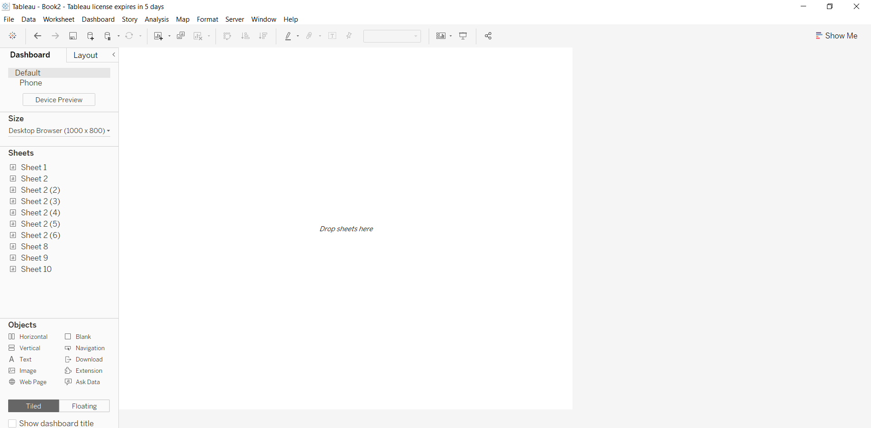
Build dashboard to show some insights.

Slide 3
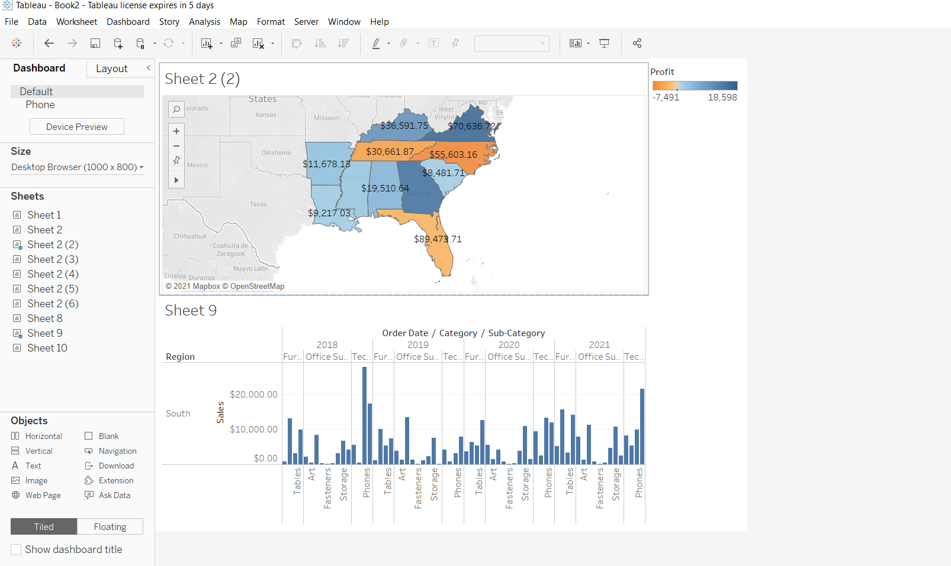

Slide 4
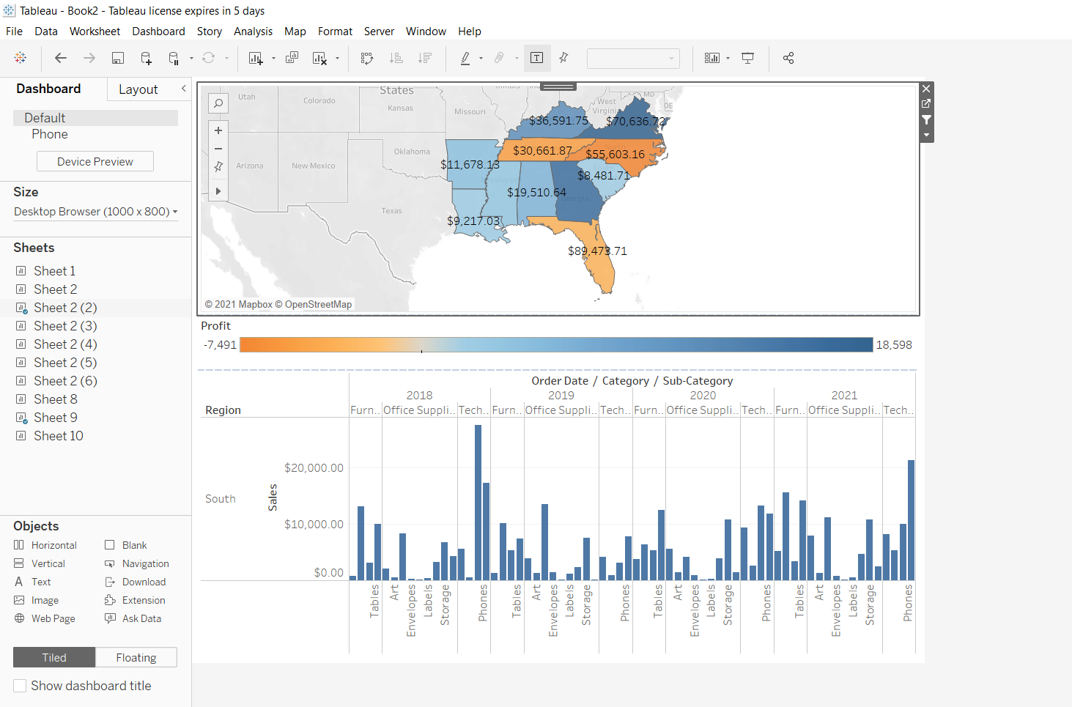

Slide 5
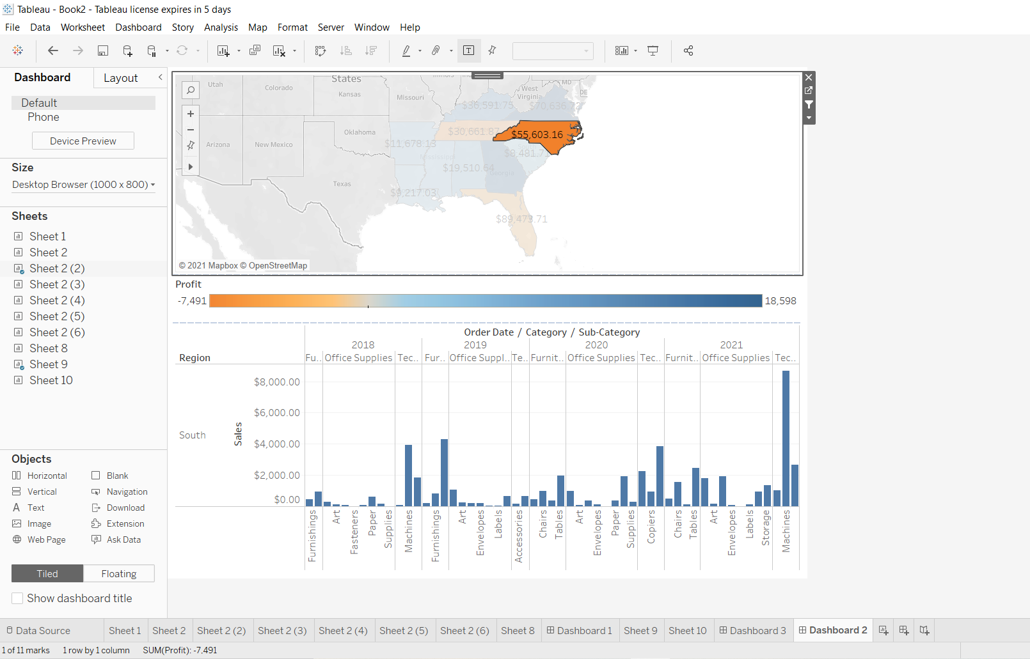
We remove the title by using hide title option and we drag the profit session at down

Slide 6
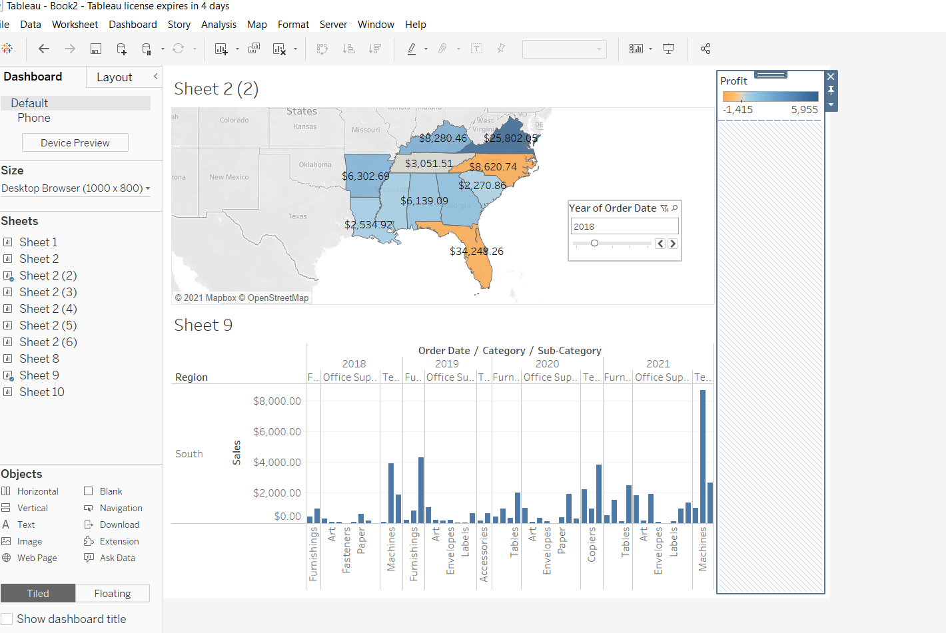
We can put slider for year to make it more interactive we can also use floating option

Slide 7
Thank You

